Slide 1
MUST_Meeting
Group Member: 胡思蓝 石浩彤 任意

Slide 2
01
Motivation & Challenges
02
Project component analysis
03
Project demonstration
04
Future work and opportunities
Outline

Slide 3


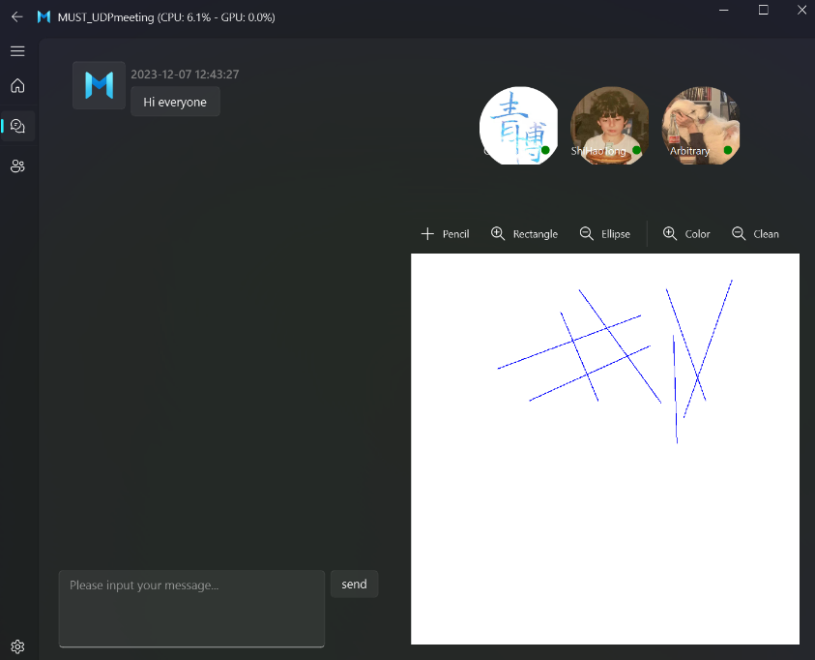
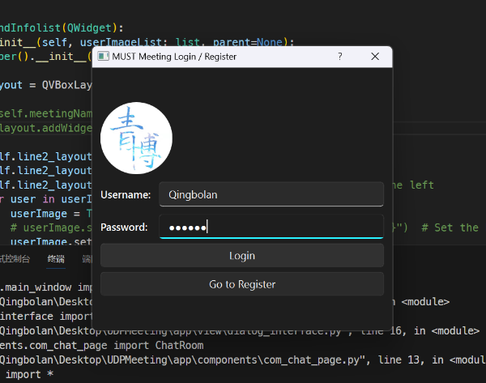
Set up the base C infrastructure of server
10-20
Implement of UI using PyQt
10-25
Implement of message transformation
10-29
Implement the function of Whiteboard
11-10
Progress
Implement of audio transformation
11-23
12-6
Finalizing the project

Slide 4




Ideas of the project
We aimed to develop a project which can realize the main function of the WeChat
Web Server setup
Message transmission
Whiteboard
Voice calls
Stage 1
Stage 2
Stage 3
Stage 4
Notes:
In the network programming course, we studied Socket programming in depth and mastered the technology of using TCP protocol to establish reliable connections and using UDP protocol to implement lightweight communication. This provides a solid foundation for us to choose the appropriate communication method. With the support of the knowledge of multi-process and multi-threading, we can realize that a server can handle the message interaction of multiple clients at the same time, which is extremely important in practical applications. Thinking about how to apply this knowledge to actual projects, we came up with the idea of developing a comprehensive application, similar to WeChat or Tencent Conference, covering functions such as chat, whiteboards and voice calls. These four are the steps we took to complete the project

Slide 5
Challenges We encountered
Socket routing
Within a LAN, it is very convenient to use internal IP addresses for communication, but extending to a WAN involves socket routing issues.
Packet loss and reordering
UDP dose not guarantee the reliability of packets.
Broadcasting and Multicasting
In multi-person chat rooms, ensure messages are delivered to all online users or to specific user groups.
Multi-threading
Using multiple threads to handle concurrent connections from multiple clients.
Notes:
However, as the project progressed, we faced a series of technical challenges. Within a local area network, it is very convenient to use internal IP addresses for communication, but when extended to a wide area network, socket routing issues are involved, especially the challenge of NAT traversal. NAT maps private IP addresses on the internal network to public IP addresses, so we need a way to traverse this mapping to ensure that clients and servers can communicate correctly across the WAN. Because the UDP protocol does not guarantee the reliability of data packets, in chat room applications, packet loss and out-of-order situations need to be dealt with. Multi-person chat rooms usually need to support broadcast and multicast functions of messages so that messages can be delivered to all online users or to a specific user group. It is common practice to use multithreading to handle simultaneous connections from multiple clients. Knowledge of multi-threaded programming is required to ensure the correctness and efficiency of concurrent access.

Slide 6
Project Component Analysis
- Web Server
- Message Transmission
- Whiteboard
- Voice Call
Notes:
Next is the second part, Project component analysis, which includes the project content we implemented step by step.

Slide 7
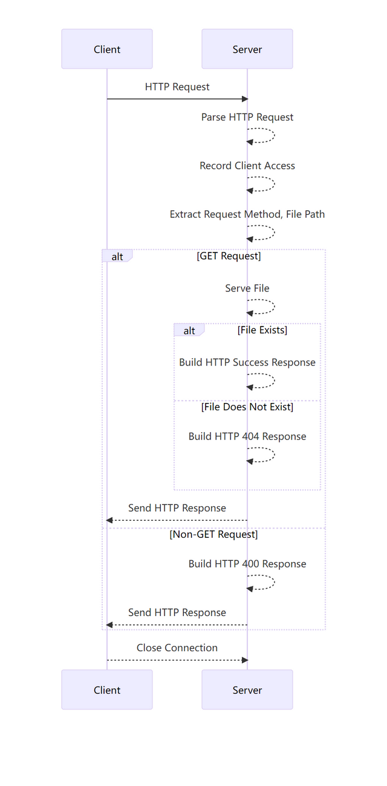
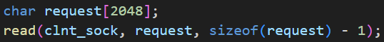
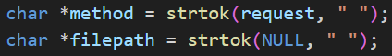
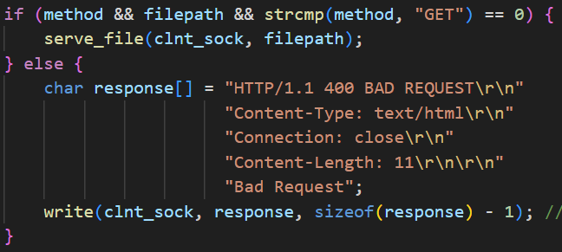
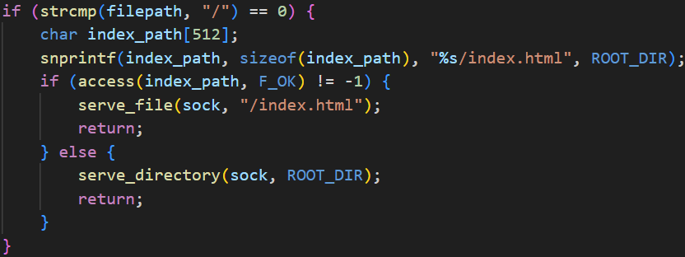
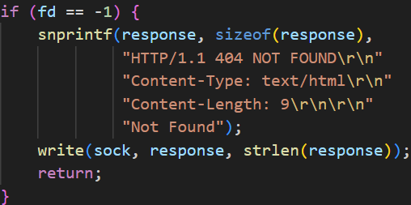
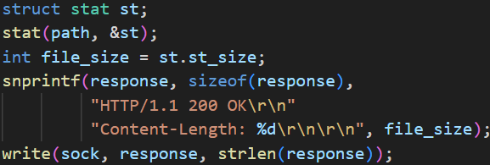
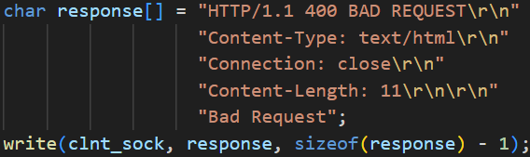
Web Server processing HTTP request process
ALLPPT
Notes:
In order to solve the problem of message forwarding in the WAN, we chose to conduct a small experiment first. We wrote a Web server in C language and implemented a basic Web server function that can handle client connection requests, parse HTTP requests, and provide File service records client access information, and uses multi-threading and mutex locks to ensure thread safety.
The sequence diagram shows the process of this server processing http requests. First, we see that after the client sends the request, the server uses the `read` function to read the HTTP request content from the client's socket, and then calls the `get_header_field` function to obtain the request header. The Host and User-Agent fields use this function to record the client's IP address, Host, User-Agent and other information. Use the `strtok` function to parse the request method and request path in the HTTP request. Next, determine whether it is a GET request. If it is a GET request, call the serve_file function. As you can see from this code:
- If the requested path is a root path ("/"), first try to serve the default index file (for example, "index.html").
- If the index file exists, call `serve_file` recursively to provide the contents of the index file.
- If the index file does not exist, a directory listing will be provided.
If the file does not exist, an HTTP 404 NOT FOUND response is returned. If it exists, the file size information is returned. You can see that if it is not a GET request, an error response is returned, such as "400 BAD REQUEST", and the connection is disconnected after the request/response is completed.

Slide 8
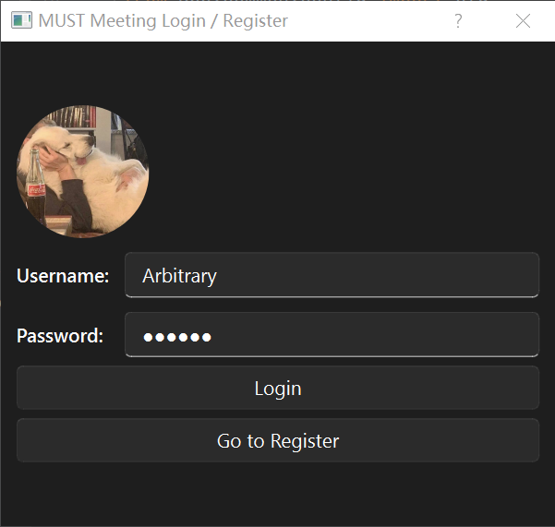
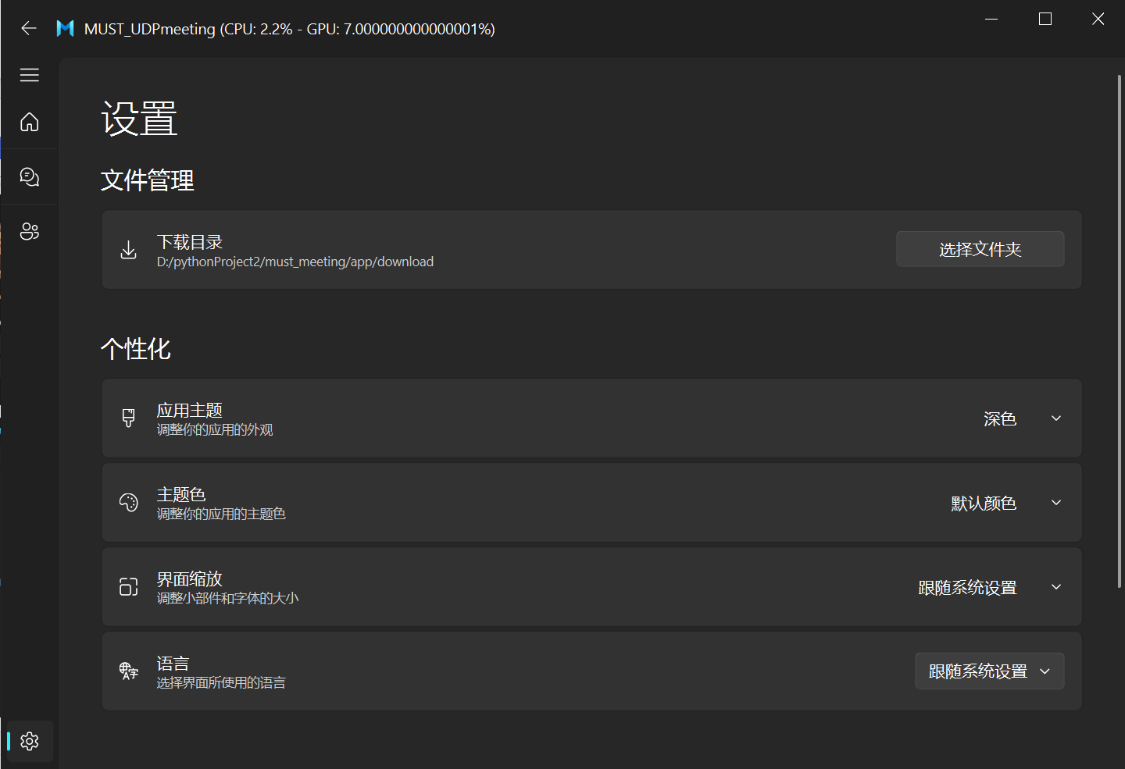
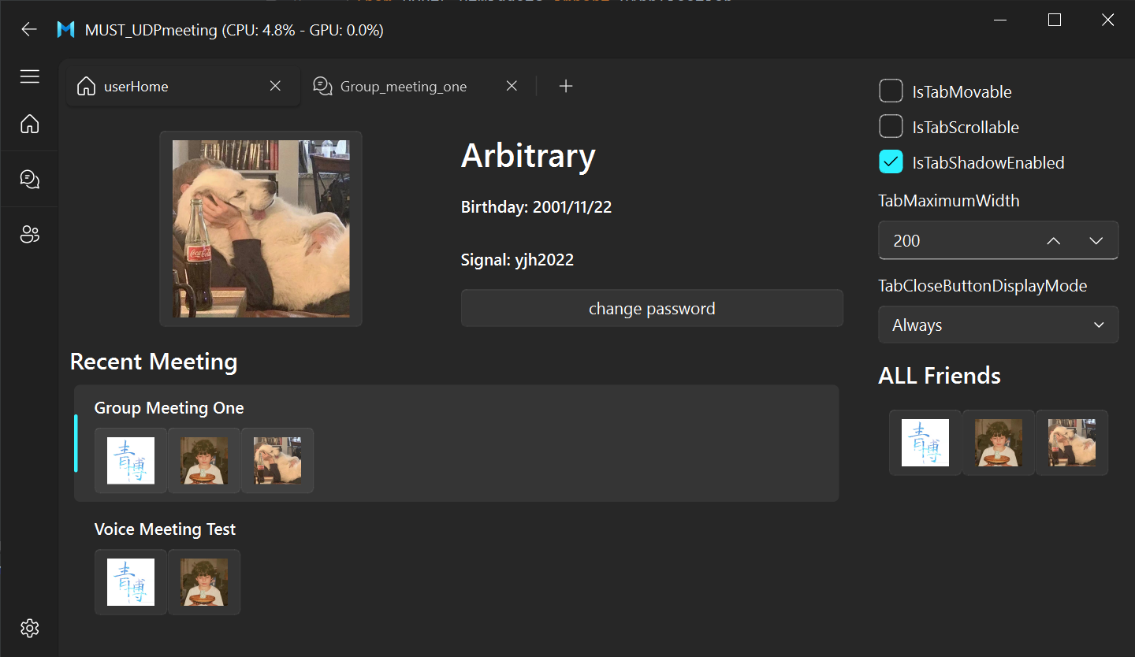
Interface Presentation
Notes:
With the foundation of creating a Web Server, we have new ideas to implement the multi-person chat function.
These are some interfaces of the MUST-Meeting software. You can see the login interface and user interface, which contain some personal information and meeting information. At the same time, we have also implemented a setting interface, such as changing the appearance and color of the theme.

Slide 9
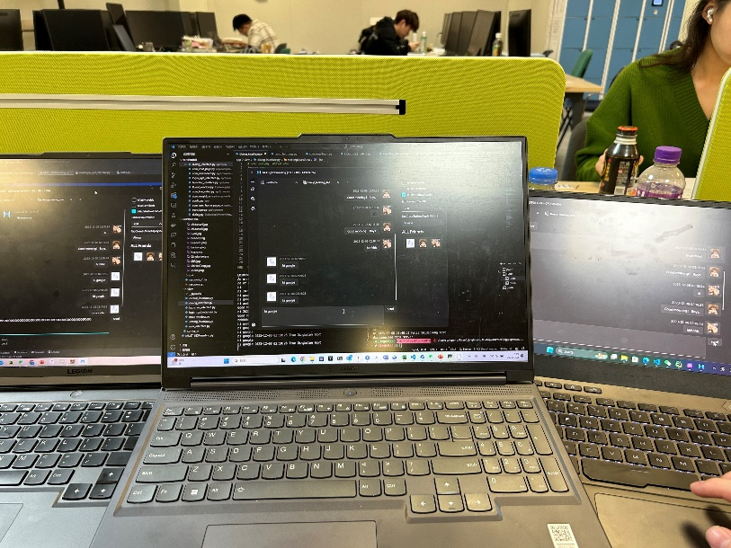
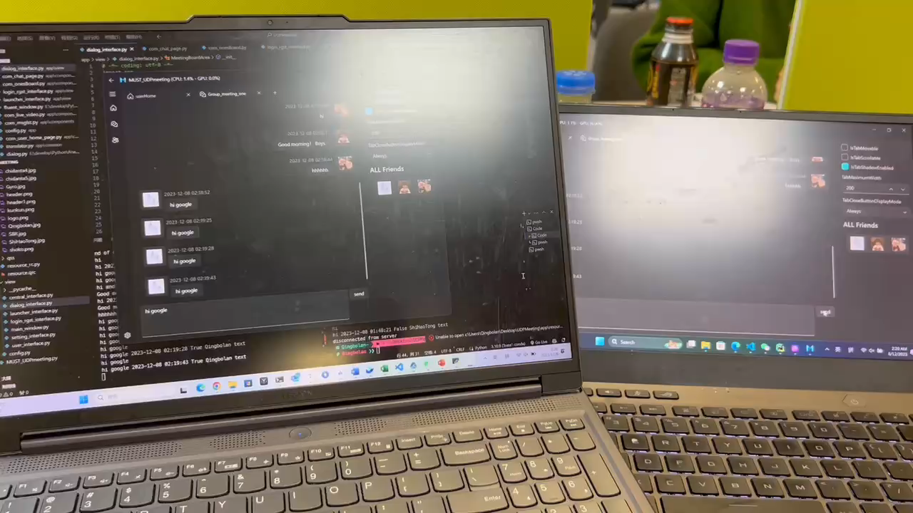
Multi-Person Chat Presentation
Notes:
You can see the implemented multi-person chat function in the video

Slide 10
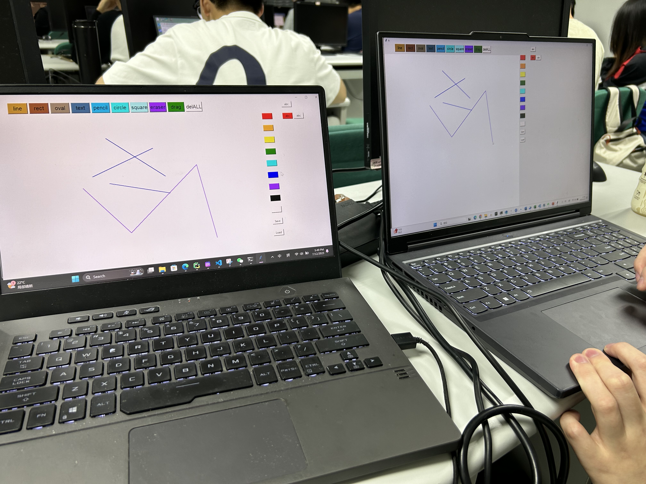
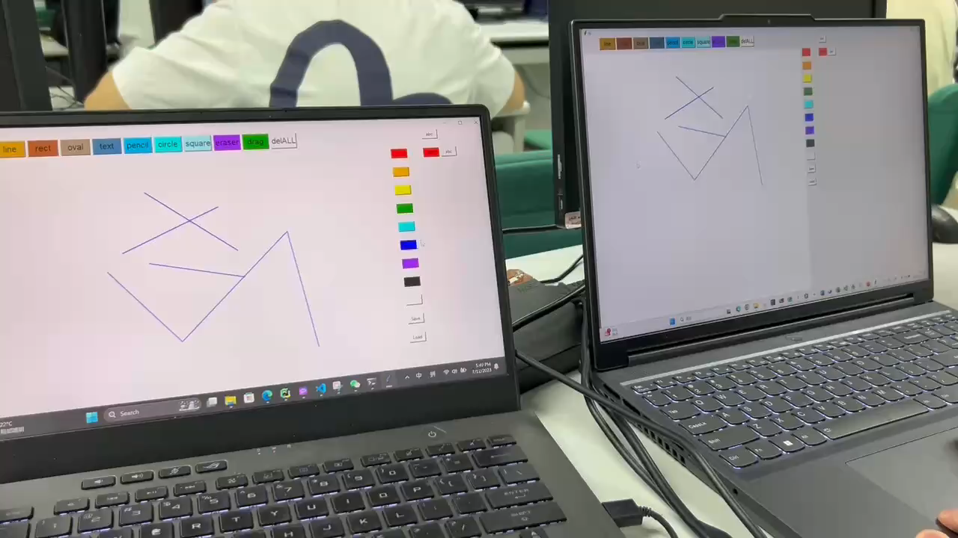
Whiteboard PRESENTATION
This function well meets the needs of the education industry.
Notes:
The whiteboard function uses the PyQt5 library to build a GUI interface, which contains a drawing area and some drawing tool buttons. Users can use the mouse to perform drawing operations on the drawing area, including using the pencil tool to draw free lines, using the rectangle and ellipse tools to draw shapes, selecting different colors, etc. The operations during the drawing process will be sent to other users through network connections to realize the function of multi-user collaborative drawing. At the same time, the application also has an eraser function and a clear canvas function.

Slide 11
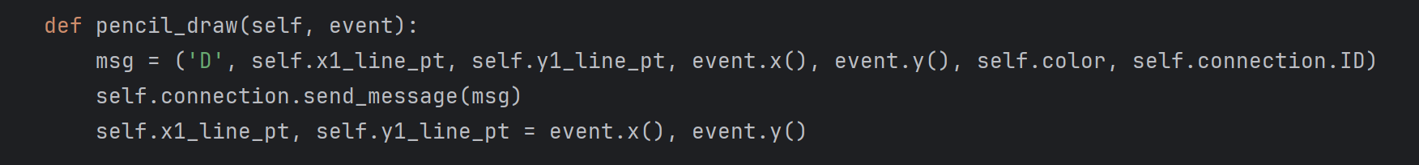
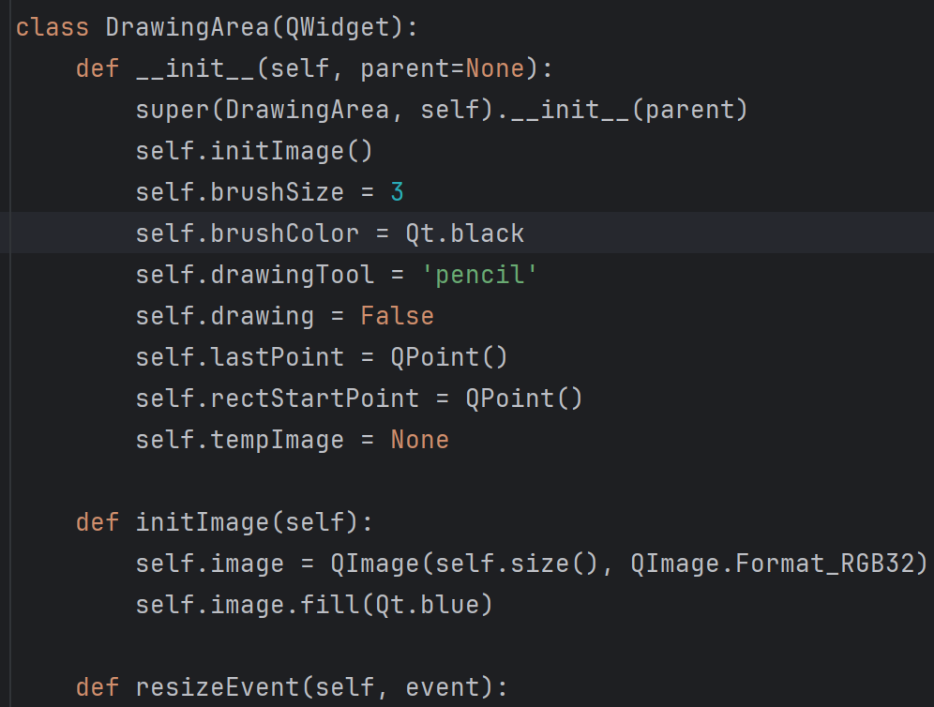
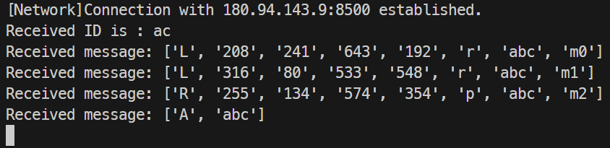
DrawingArea（）
drawLineTo()
drawShape
Notes:
DrawingArea: This class represents the drawing area where users can interact with the whiteboard. It handles mouse events such as mouse press, move, andrelease.
mousePressEvent: Handles the mouse press event and sets the drawing flag to true.
drawLineTo: Draws a line from the last point to the current point.
drawShape: Draws a shape (rectangle or ellipse) based on the selected drawing tool.
paintEvent: Paints the canvas using the image buffer.

Slide 12
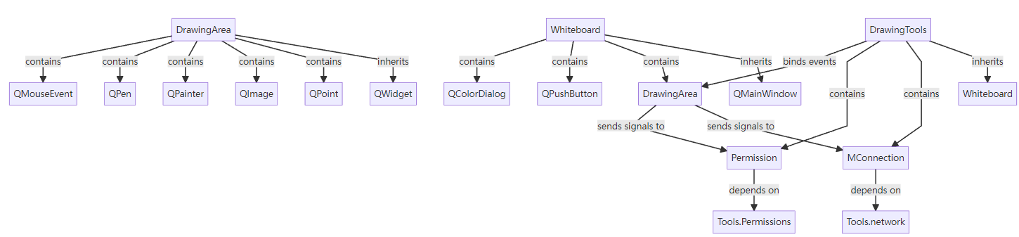
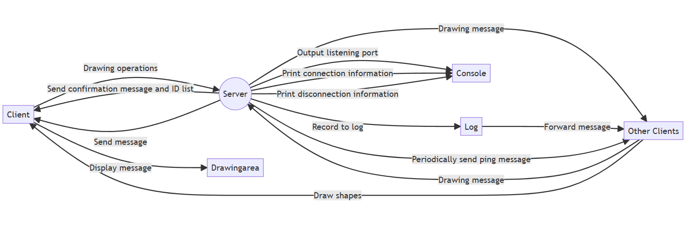
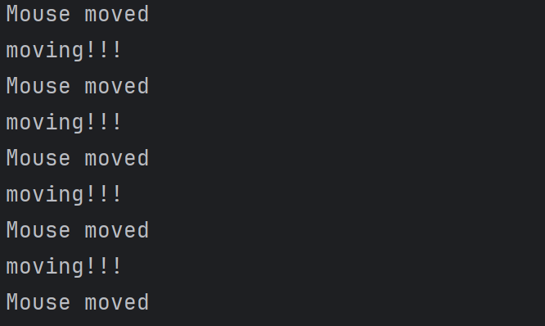
White Board Presentation
Notes:
服务器使用socket库创建一个TCP套接字，绑定到指定的主机和端口，并开始监听连接请求。服务器线程通过循环接受新的连接请求，每当有新的客户端连接，服务器向客户端发送确认消息，并分配一个唯一的客户端ID。服务器还发送当前已连接客户端的ID列表给新连接的客户端，以构建权限系统。服务器创建一个新的客户端线程来处理新连接的客户端。该线程接收客户端发送的消息，并根据消息类型进行处理。服务器通过定期发送ping消息来检测客户端的连接状态。如果客户端断开连接，服务器发送删除消息通知其他客户端，并从客户端列表中移除该客户端。画图原理：客户端在绘图区域进行绘图操作，例如绘制线条、形状等。绘制过程中的操作会发送给服务器。客户端发送的绘图消息会被服务器接收并广播给所有其他客户端，实现多用户之间的绘图同步。服务器接收到绘图消息后，将其记录到日志中，并将消息转发给所有其他客户端。客户端接收到绘图消息后，在自己的绘图区域上进行绘制，保持与其他客户端的绘图同步。

Slide 13
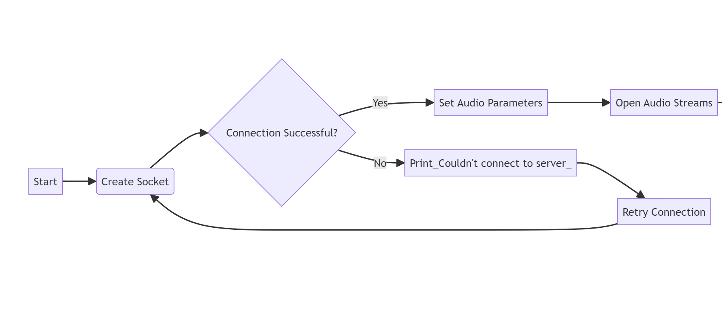
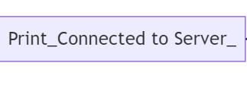
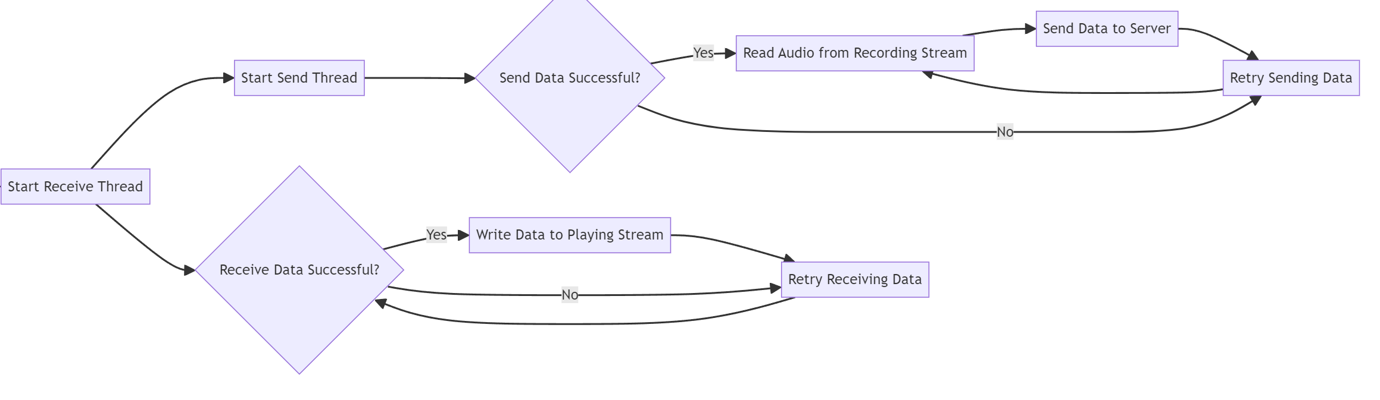
Mermaid chart of voice Call

Slide 14
Project demonstration

Slide 15
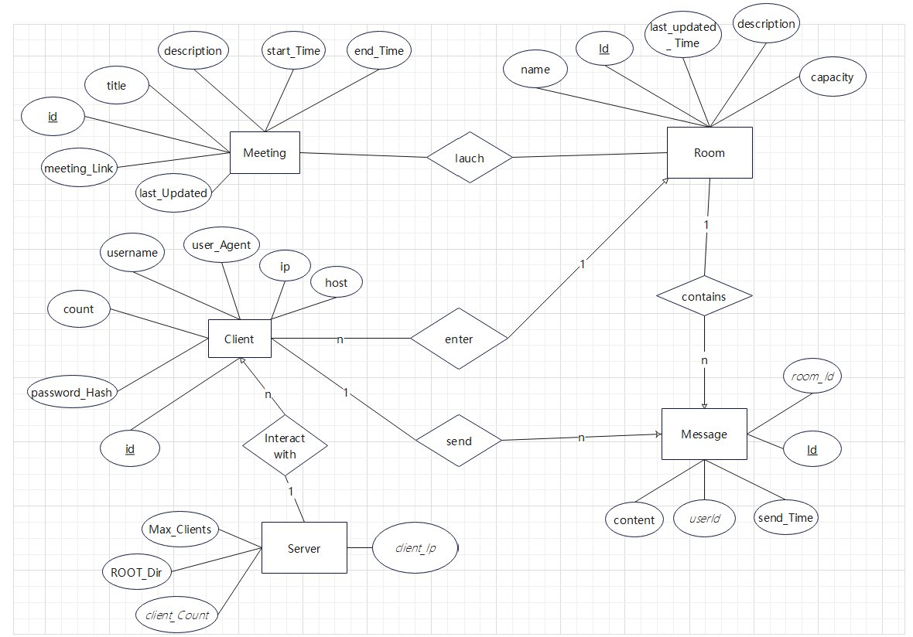
ER-Diagram
Notes:
the main entity is the "Room" which has a one-to-many relationship with the “Client" entity. The "Room" contains information like the room ID, room name, and a list of users who are part of that chat room.Each "User" has a one-to-one relationship with the "Connection" entity, representing their connection status to the chat server. The "User" entity also includes information such as the user ID, and a list of messages sent by that client. The “Client" entity has a one-to-many relationship with the "Message" entity, representing the messages sent by each user. Each "Message" has foreign key room_Id and clientId , message content, and send_Time. Server record The max_clients and Root_directory and also includes a foreign key: Client_account and client_ip.

Slide 16
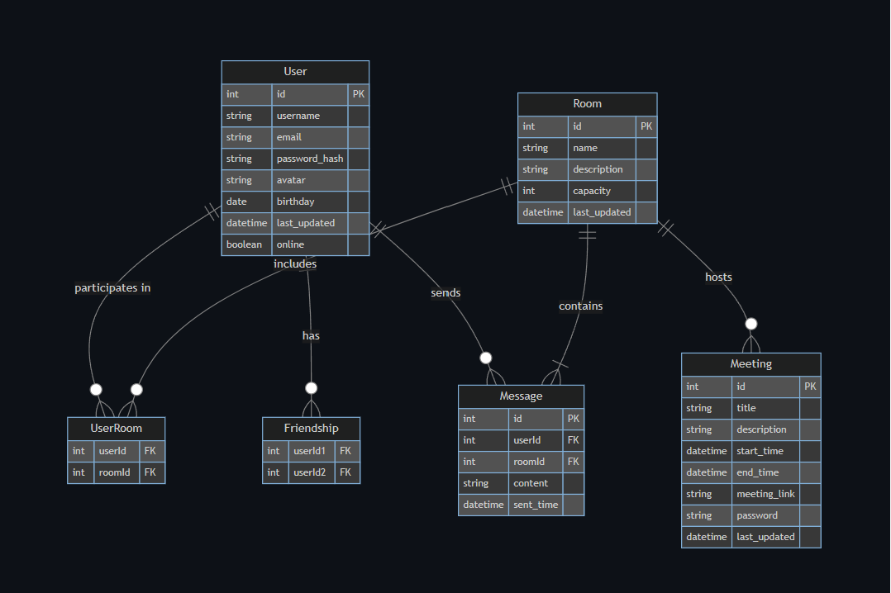
Server entity relationship diagram
Notes:
This Graph can help you to understand the relation between User and room, message and meeting better. And also pointed out the parameter type of each attributes.

Slide 17
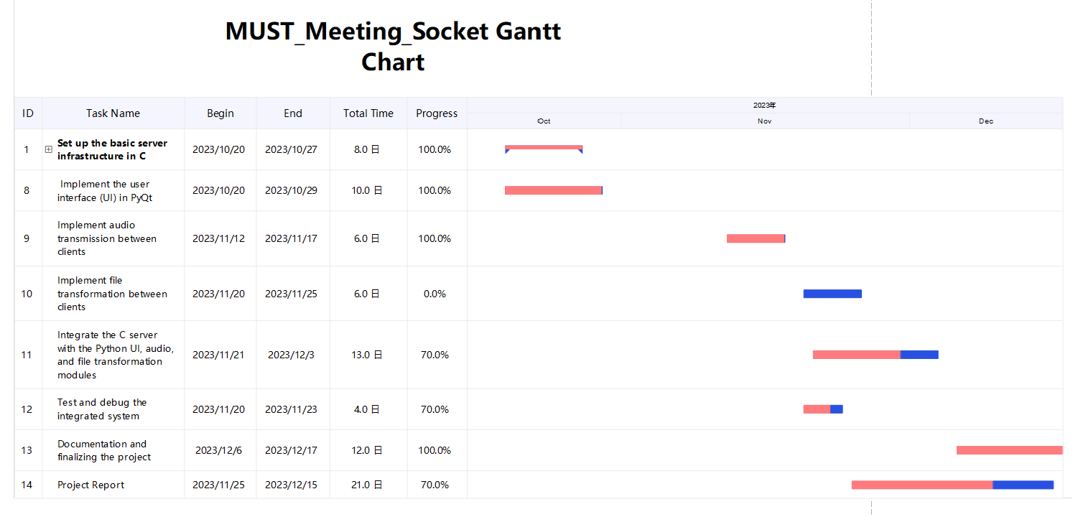
Gantt chart
Notes:
The gantt chart demonstrate the process and time schedule of development. Due to the limitation of our time , We aimed to implement the file

Slide 18
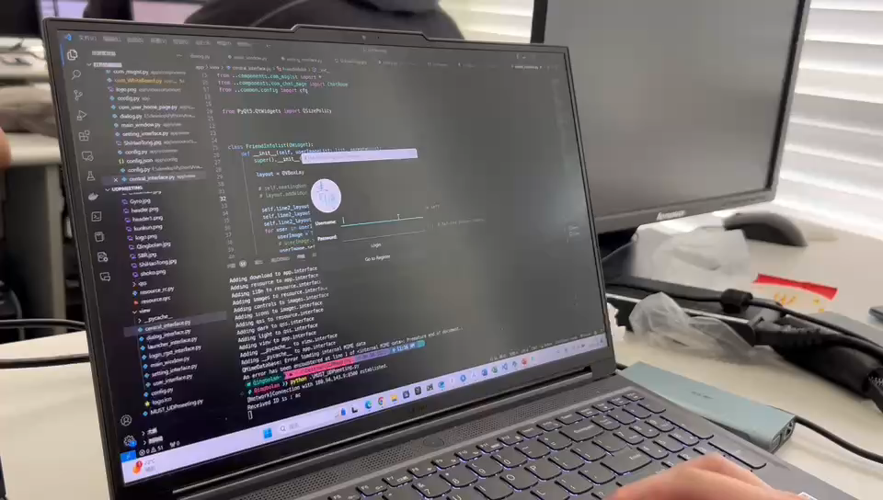
Show One

Slide 19
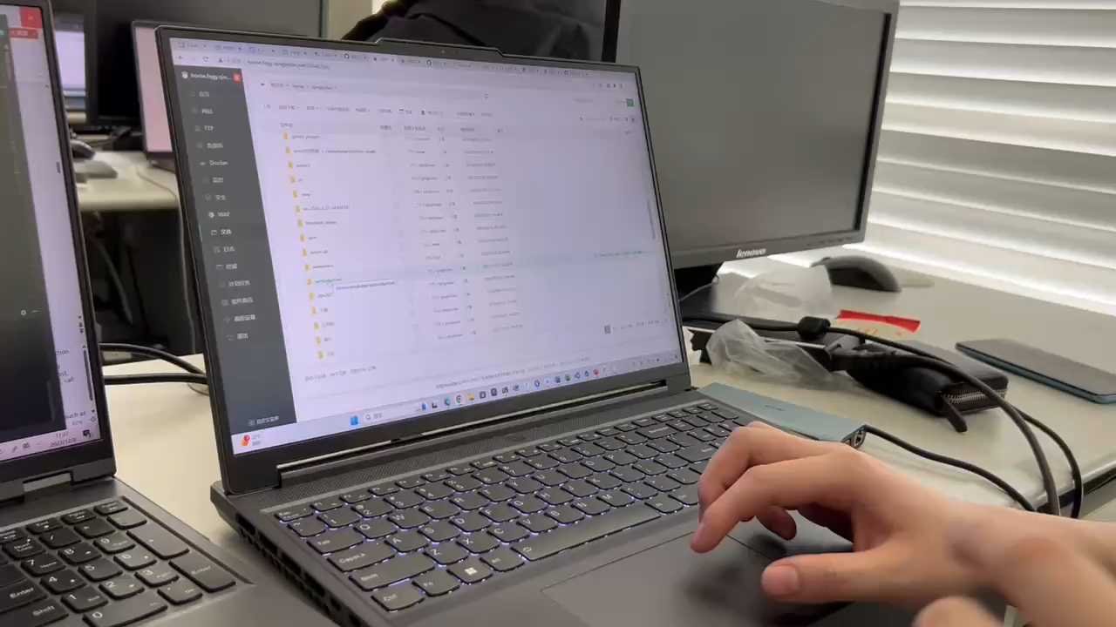
Show Two

Slide 20
Future developments and opportunities
MUST_Meeting

Slide 21
Opportunities
Support for Additional HTTP Methods
Authentication and Authorization
Currently, the server only supports the GET method..
3
4
Implementing user authentication and authorization mechanisms can provide secure access control to resources on the server.
Performance Optimization
Support for Dynamic Content
The server could be optimized for better performance.
2
5
Currently, the server mainly serves static files.
Enhance security
API Support
Strengthening the security of the web server should be a priority.
1
6
Transforming the server into a web API server can enable clients to interact with it programmatically.
Notes:
There are several potential future developments and opportunities for the web server implemented in the given code snippet:
1. Enhanced Security: Strengthening the security of the web server should be a priority. This can include implementing input validation and filtering to prevent common web vulnerabilities such as SQL injection and cross-site scripting (XSS). Additionally, implementing secure communication protocols like HTTPS can help protect the confidentiality and integrity of data transmitted between the server and clients.
2. Performance Optimization: The server could be optimized for better performance. This can involve techniques such as implementing caching mechanisms to reduce the load on the server, optimizing file I/O operations, and employing techniques like load balancing and clustering to distribute the incoming requests across multiple server instances.
3. Support for Additional HTTP Methods: Currently, the server only supports the GET method. Expanding its functionality to support other HTTP methods like POST, PUT, and DELETE would allow clients to perform a wider range of actions on the server resources, enabling more advanced web applications.
4. Authentication and Authorization: Implementing user authentication and authorization mechanisms can provide secure access control to resources on the server. This can involve integrating with existing authentication systems or implementing custom authentication mechanisms like username/password-based authentication or token-based authentication.
5. Logging and Analytics: Enhancing logging capabilities can provide valuable insights into server operations, client behavior, and potential security incidents. Implementing comprehensive logging and analytics can help monitor server performance, track user activity, detect anomalies, and facilitate troubleshooting and auditing.
6. Support for Dynamic Content: Currently, the server mainly serves static files. Adding support for server-side scripting languages like PHP, Python, or Node.js would enable the server to generate dynamic content and interact with databases, opening up possibilities for more interactive and data-driven web applications.
7. Scalability and High Availability: As the server grows and handles more traffic, ensuring scalability and high availability becomes crucial. Implementing techniques like horizontal scaling, where multiple instances of the server run on different machines, and setting up load balancers can help distribute the incoming traffic and ensure the server remains available even during high load or failure scenarios.
8. API Support: Transforming the server into a web API server can enable clients to interact with it programmatically. This can involve implementing RESTful API endpoints or supporting popular API standards such as GraphQL, making it easier for developers to integrate the server into their applications.
These future developments and opportunities can enhance the functionality, security, performance, and usability of the web server, allowing it to meet evolving requirements and cater to a broader range of applications and use cases.

Slide 22
THANK YOU
Insert the Subtitle of Your Presentation

